Slide 1
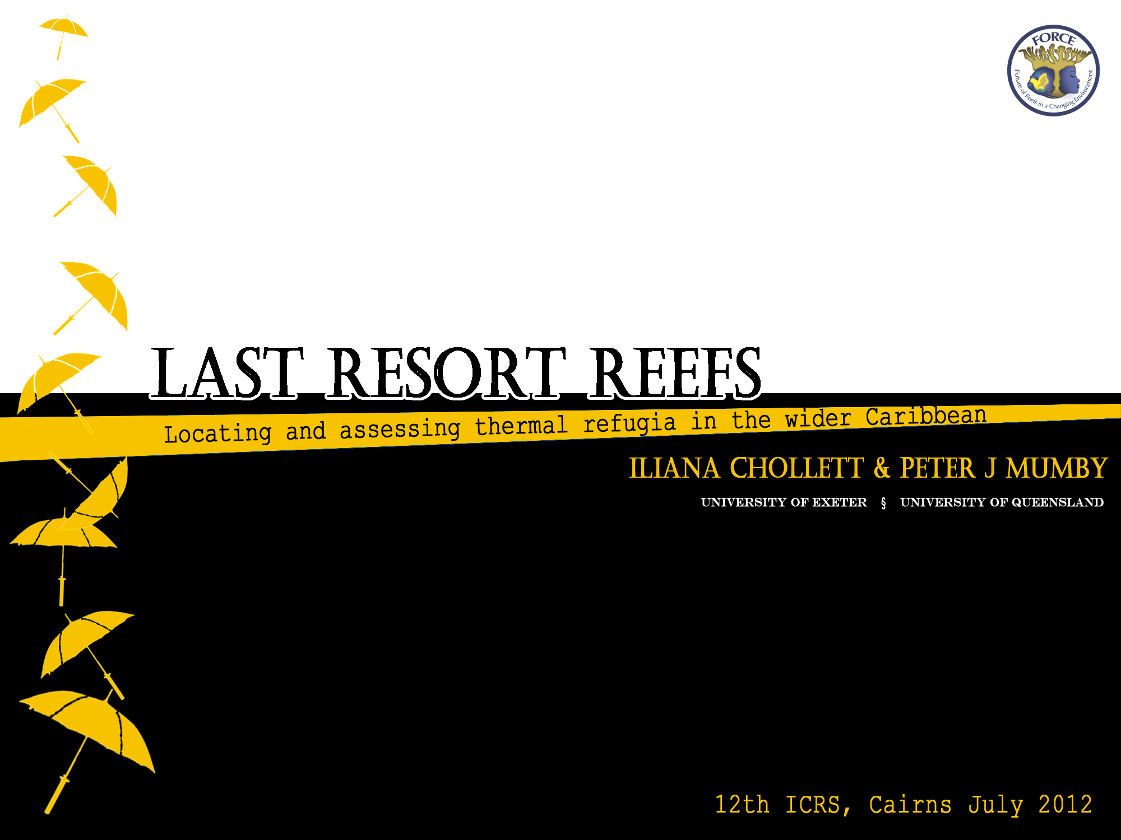








Slide 2
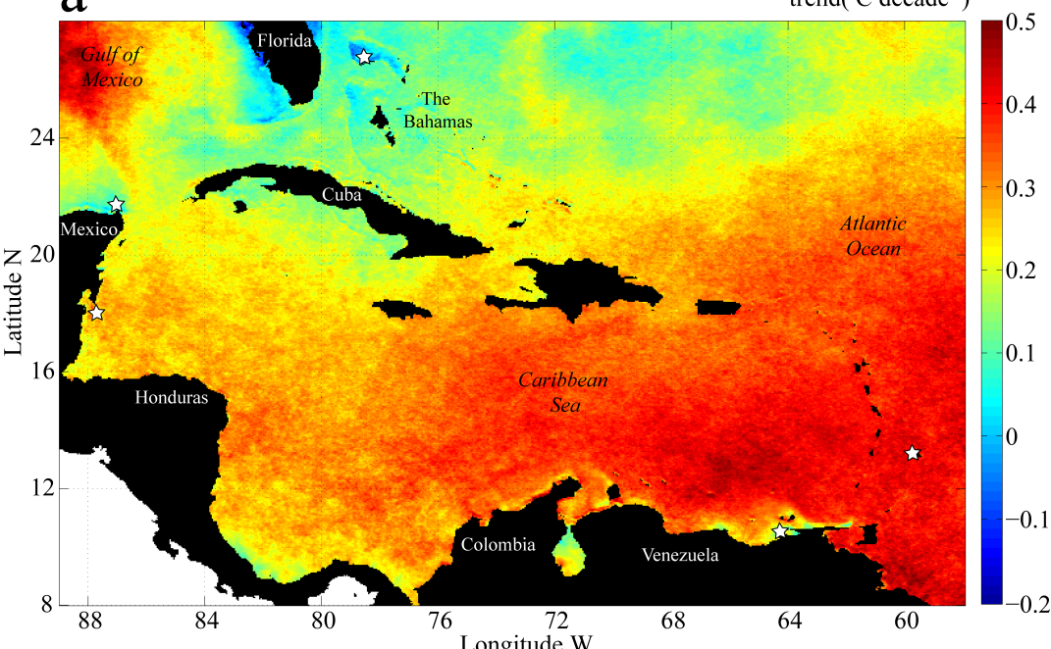
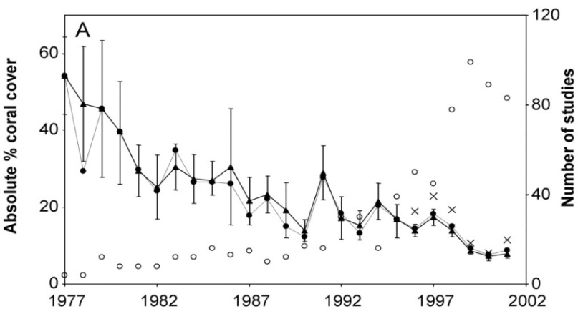
Climate change poses severe threats to coral reefs NOW
This is an issue particularly in the Caribbean
°C dec⁻¹
0.5
0.4
0.3
0.2
0.1
0.0
-0.1
-0.2
SST trends 1987-2008 (Chollett et al. 2012)
Coral cover trend (1977-2001)
(Gardner et al. 2003)

Slide 3

…Uncertainty…
The rise of thermal stress has led to speculation that reef ecosystems may become increasingly restricted to locations of naturally low thermal stress
Reefs will need to hide
Coral reefs would need to survive in refugia:*
Deep water areas
Deep water areas
Upwelling systems
High latitude areas
Sites exposed to vigorous circulation
* Glynn 1996, Nakamura & van Woesik 2001, Riegl and Piller 2003, West and Salm 2003

Slide 4

…But…
is the “Refugia hypothesis” still valid?
YES! Still around
e.g. Baker et al. 2008, McLeod et al. 2009, ICRS 2012
►A formal test is needed
NO! Recent emphasis in environmental variability and acclimation
e.g. Donner 2011, Thompson and van Woesik 2009
►Do not move on without a proper assessment
We tested the three remaining hypotheses in the wider Caribbean
Here
Map the hypothesised refugia
Quantify the extent to which they minimize thermal stress

Slide 5
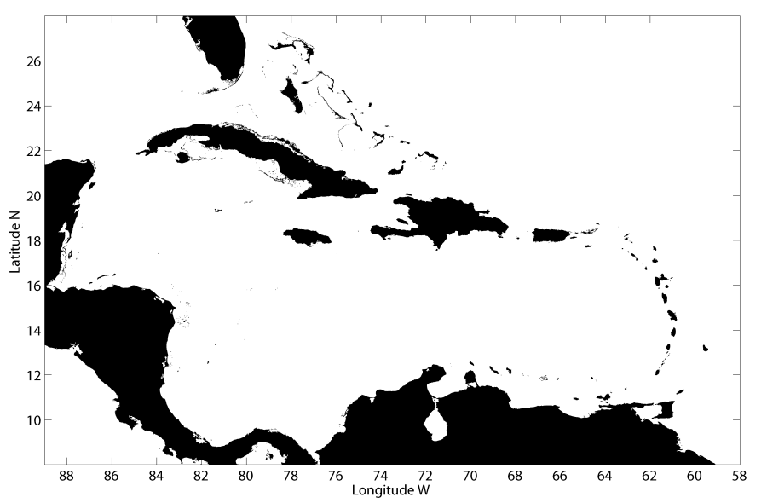
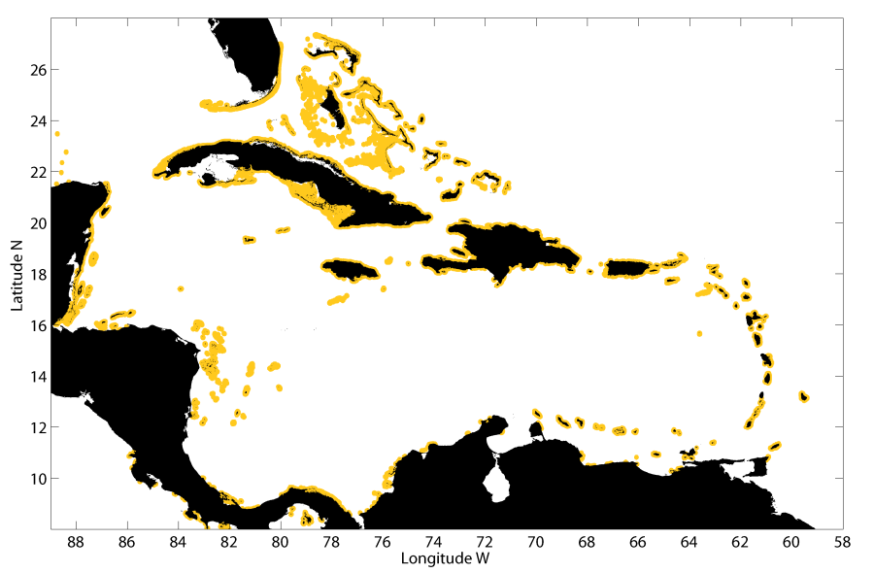
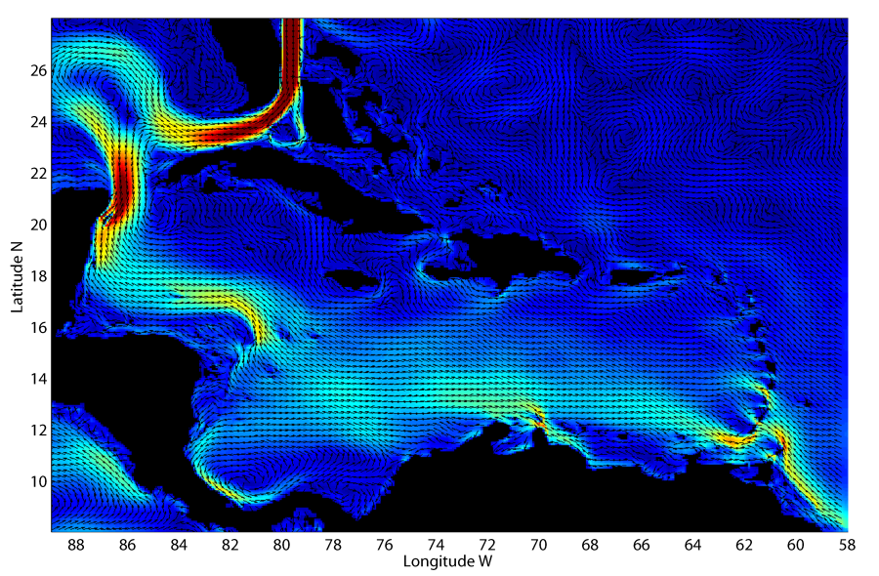
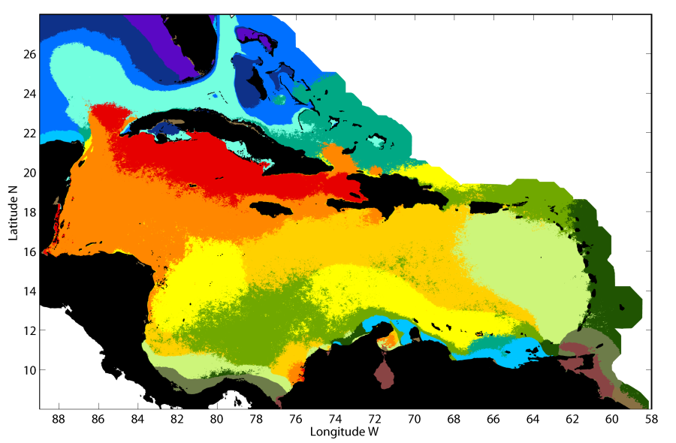
Locating refugia areas for reefs in the Caribbean
Checklist:
✓
Map (GSHHS)
✓
Reef locations (MCRMP, 10 km buffer)
✓
Refugia proxies
Caribbean Sea
Refugia | Proxy | Source | Method
Strong mixing | Current Speed | HYCOM 2008-2010, 7 km (Chassignet et al. 2007) | Average speed >0.4 m/s
Upwelling | Physicochemical signal | PECS classification, 1 km (Chollett et al. 2012) | Cluster 11
High latitude | Physicochemical signal | PECS classification, 1 km (Chollett et al. 2012) | Clusters 12 and 16
Refugia | Proxy | Source | Method
Strong mixing | Current Speed | HYCOM 2008-2010, 7 km (Chassignet et al. 2007) | Average speed >0.4 m/s
Upwelling | Physicochemical signal | PECS classification, 1 km (Chollett et al. 2012) | Cluster 11
High latitude | Physicochemical signal | PECS classification, 1 km (Chollett et al. 2012) | Clusters 12 and 16
Refugia | Proxy | Source | Method
Strong mixing | Current Speed | HYCOM 2008-2010, 7 km (Chassignet et al. 2007) | Average speed >0.4 m/s
Upwelling | Physicochemical signal | PECS classification, 1 km (Chollett et al. 2012) | Cluster 11
High latitude | Physicochemical signal | PECS classification, 1 km (Chollett et al. 2012) | Clusters 12 and 16
PECS: Physical Environments of the Caribbean Sea

Slide 6
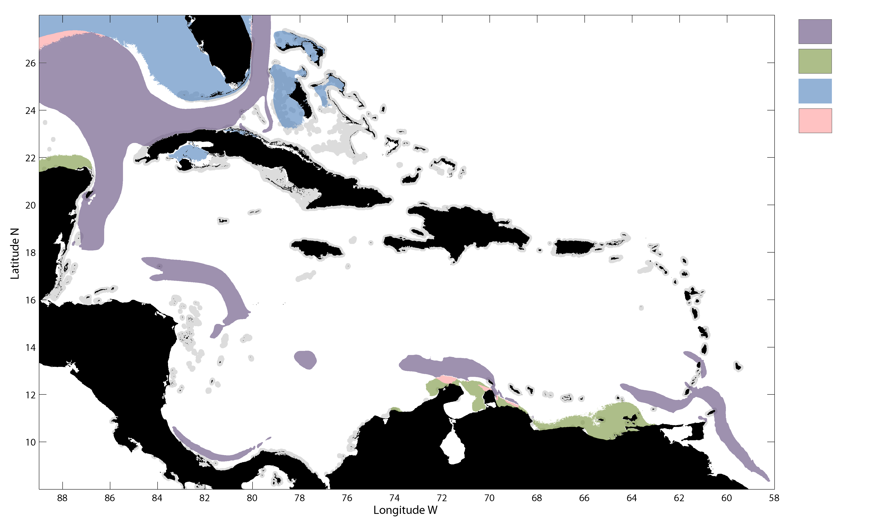
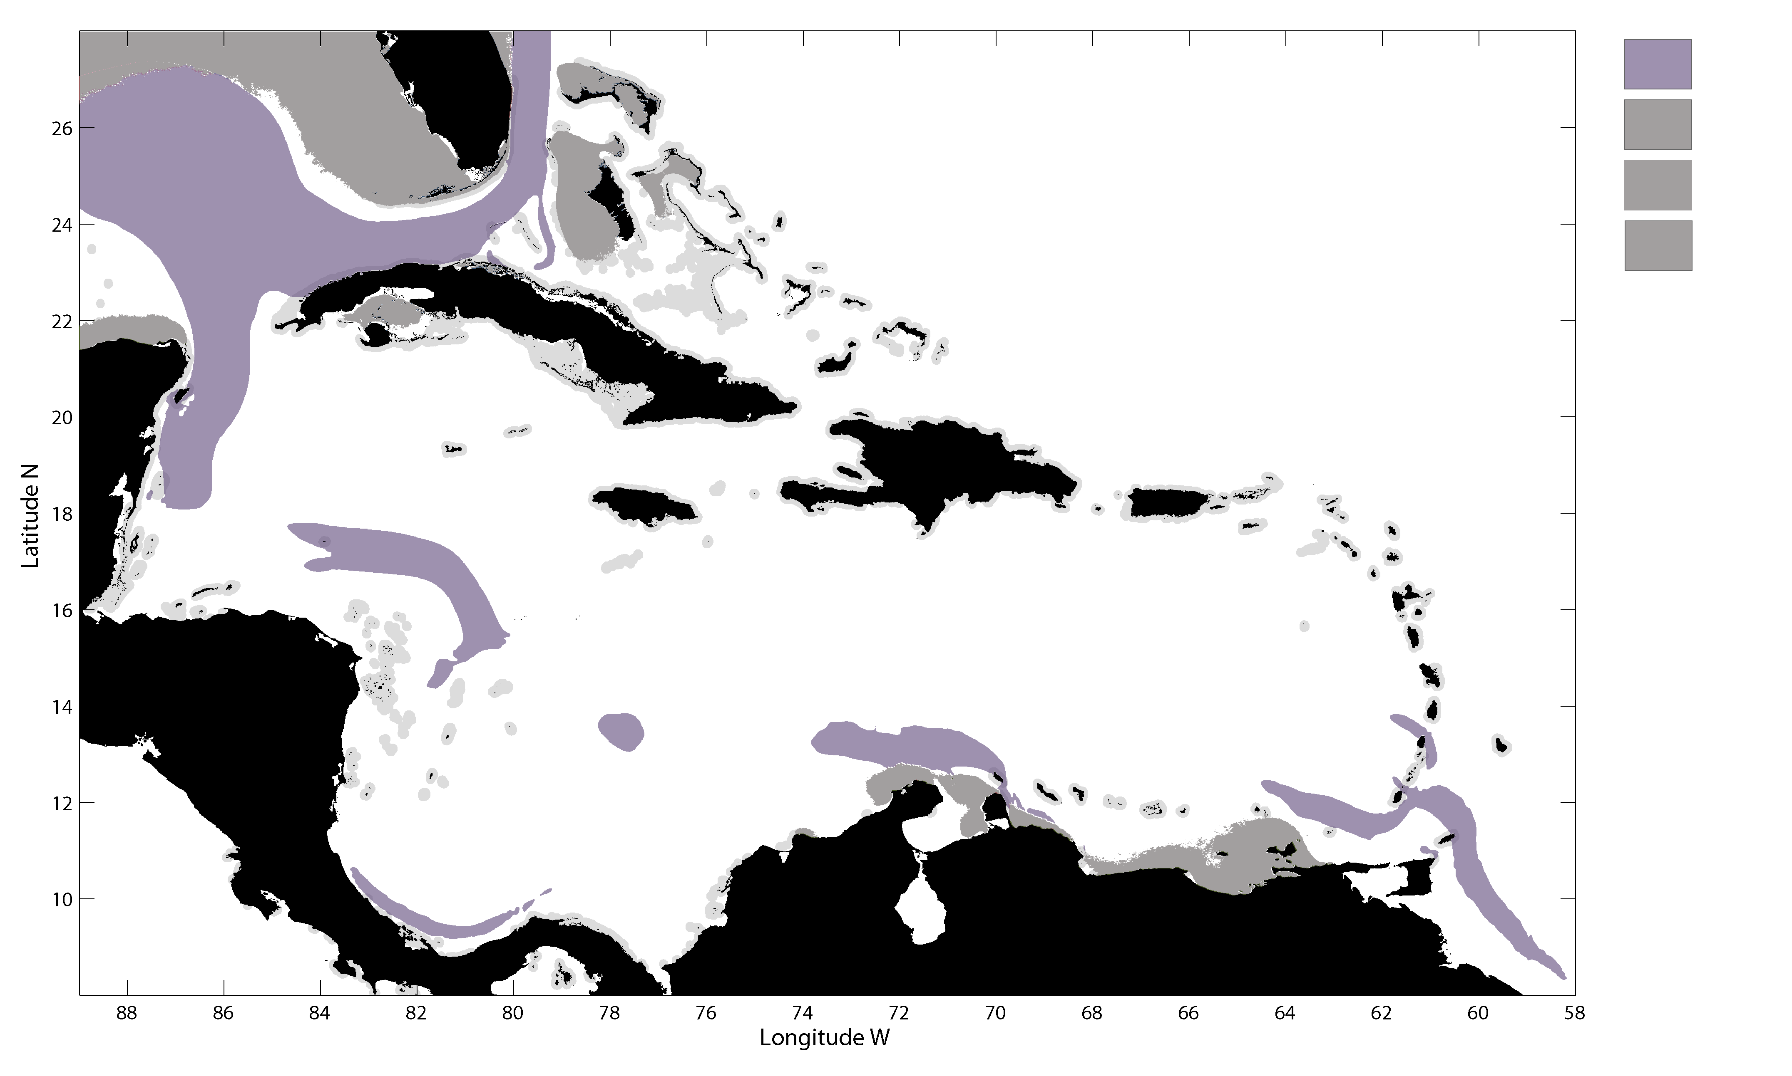
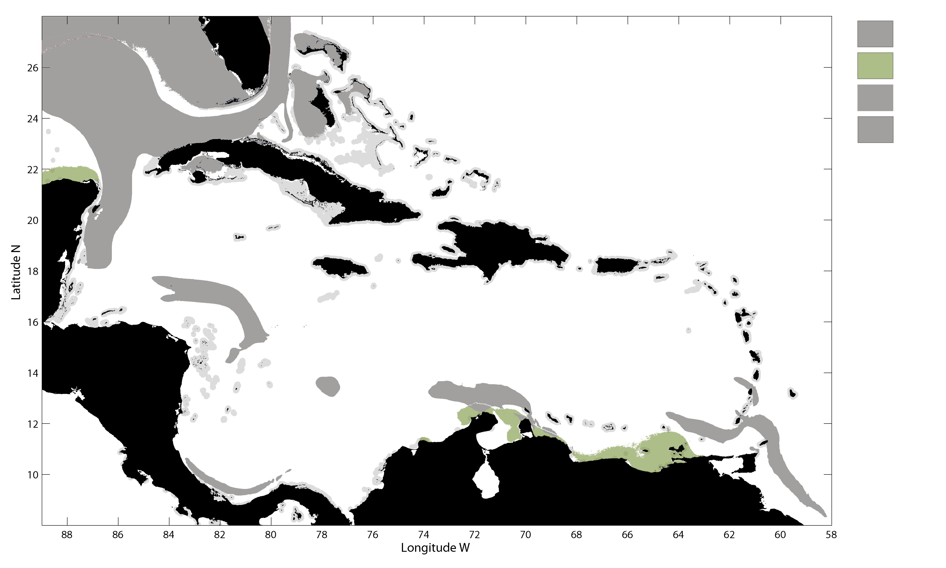
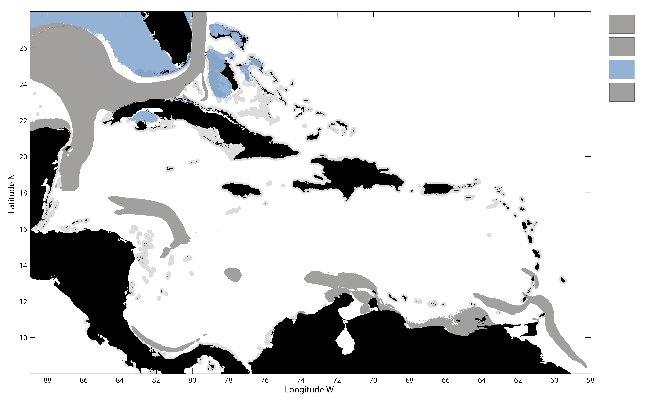
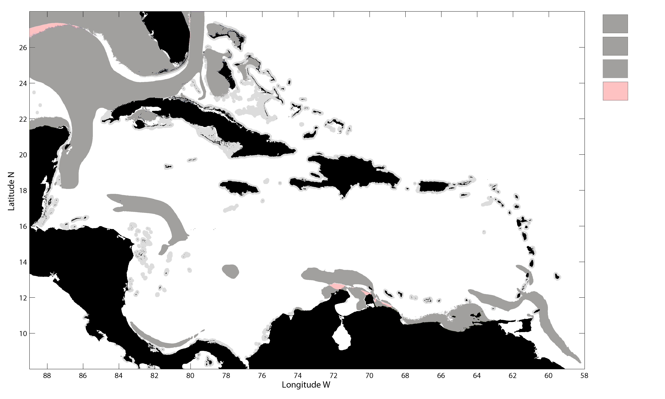
Strong mixing
Strong mixing
Upwelling
Upwelling
High latitude
High latitude
Mixed

Slide 7
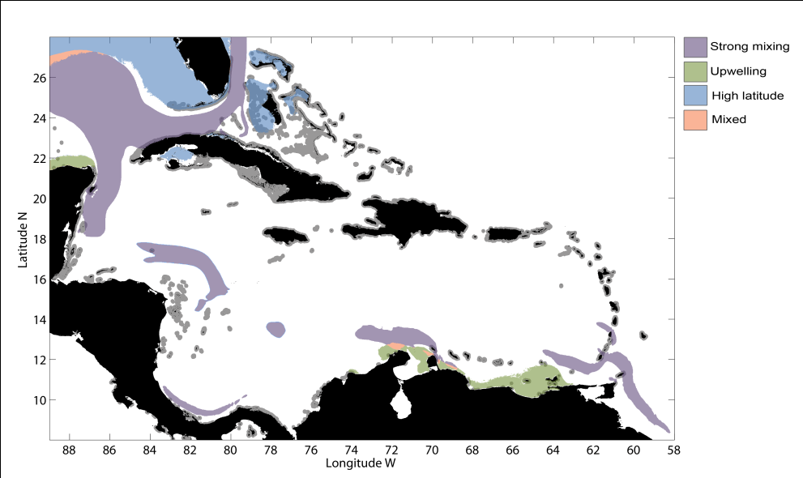
Distribution of putative refugia across the wider Caribbean
Refuge | Surface area (km²) | Percentage area (%) | Surface area near reefs (km²) | Percentage area near reefs (%)
Strong mixing | 542,534 | 8.77 | 13,986 | 2.8
Upwelling | 76,449 | 1.25 | 6,752 | 1.75
High latitude | 224,428 | 3.63 | 38,779 | 10.02
Mixed | 12,067 | 0.20 | 190 | 0.04
Refuge | Surface area (km²) | Percentage area (%) | Surface area near reefs (km²) | Percentage area near reefs (%)
Strong mixing | 542,534 | 8.77 | 13,986 | 2.8
Upwelling | 76,449 | 1.25 | 6,752 | 1.75
High latitude | 224,428 | 3.63 | 38,779 | 10.02
Mixed | 12,067 | 0.20 | 190 | 0.04
Refuge | Surface area (km²) | Percentage area (%) | Surface area near reefs (km²) | Percentage area near reefs (%)
Strong mixing | 542,534 | 8.77 | 13,986 | 2.8
Upwelling | 76,449 | 1.25 | 6,752 | 1.75
High latitude | 224,428 | 3.63 | 38,779 | 10.02
Mixed | 12,067 | 0.20 | 190 | 0.04
Refuge | Surface area (km²) | Percentage area (%) | Surface area near reefs (km²) | Percentage area near reefs (%)
Strong mixing | 542,534 | 8.77 | 13,986 | 2.8
Upwelling | 76,449 | 1.25 | 6,752 | 1.75
High latitude | 224,428 | 3.63 | 38,779 | 10.02
Mixed | 12,067 | 0.20 | 190 | 0.04

Slide 8
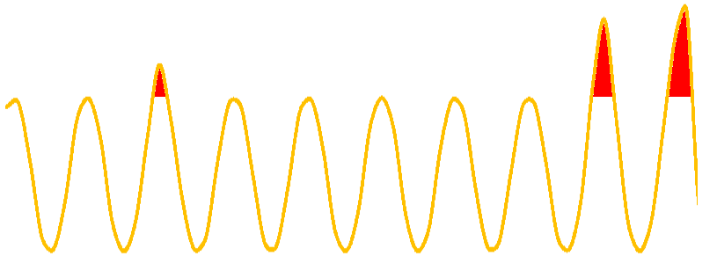
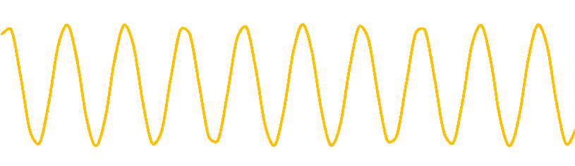
Quantifying the extent to which they minimize thermal stress
Dataset: AVHRR Pathfinder v 5.2 (1982-2010), 4 km
Thermal stress metrics:
Chronic stress = MMM
Acute stress= ∑DHW>4
Refugia
MMM
SST
Buffer (12 km)
Non-refugia (100 km)
time
Analysis: Thermal stress ~ refugia (0/1) + region (random)

Slide 9
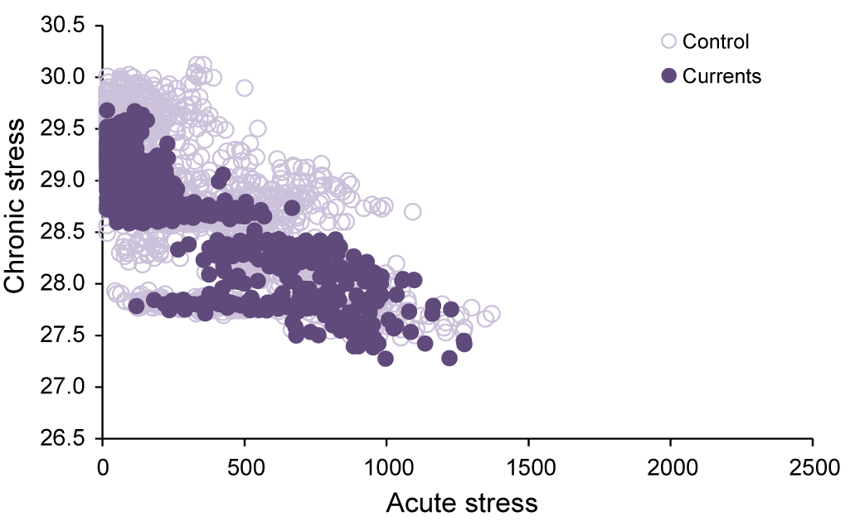
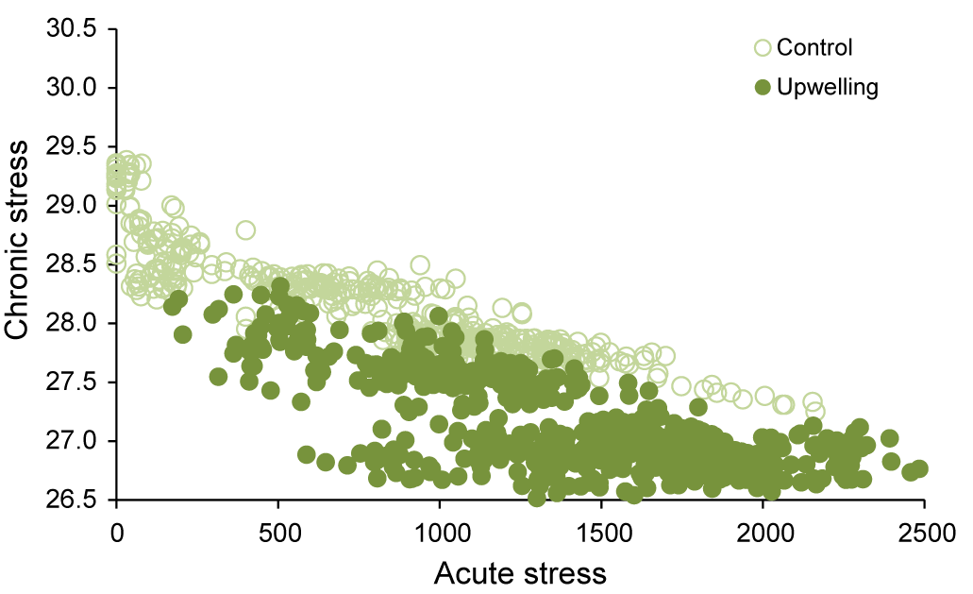
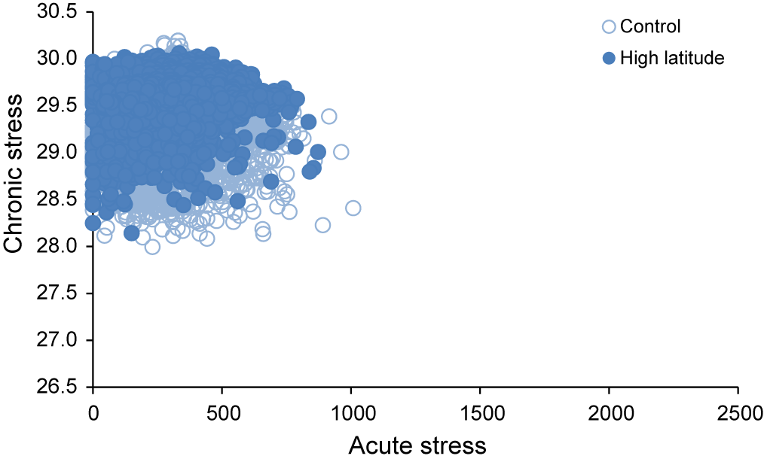
Mixing
Upwelling
Average, non-refugia
Average, refugia
High latitude
Refugia | Chronic | Acute
Strong mixing
Upwelling
High latitude
*
n.s.
*
-
-
n.s.

Slide 10
Refugia cover 14% of areas near reefs in the Caribbean. High latitude refugia is the most widespread near reefs
None of the hypothesized refugia constitute a significant protection from acute thermal stress
Only upwelling areas constitute meaningful refugia from chronic thermal stress
Need to examine other advantages of refugia areas
Refuge | Direct effects | Minimizes
Strong mixing | Decrease of SST Transport of harmful by-products away | Thermal stress Thermal/radiative stress
Upwelling | Decrease of SST Decrease of light Provision of heterotrophic food resources | Thermal stress Radiative stress Post-bleaching mortality
High latitude | Decrease of SST | Thermal stress

Slide 11
We are facing rapid climate change. Given the magnitude of the threat, it is crucial that the utility of potential solutions is assessed swiftly and thoroughly, that we may gain maximum use of the limited time available to respond.

Slide 12





Thanks!
The European Union (FORCE project)
Data providers of freely available datasets: AVHRR Pathfinder, MCRMP, HYCOM, GSHHS
Any inquiries please contact
i.c.chollett-ordaz@ex.ac.uk
To all members of MSEL for valuable comments and discussions
Marine Spatial Ecology Laboratory
Here and there: University of Queensland, University of Exeter

Slide 13
Baker, A. C., P. W. Glynn, and B. Riegl. 2008. Climate change and coral reef bleaching: an ecological assessment of long-term impacts, recovery trends and future outlook. Estuar. Coast. Shelf Sci. 80: 435-471.
Bongaerts, P., T. Ridgway, E. Sampayo, and O. Hoegh-Guldberg. 2010. Assessing the ‘deep reef refugia’ hypothesis: focus on Caribbean reefs. Coral Reefs 29: 309-327.
Chassignet, E. P., H. E. Hurlburt, O. M. Smedstad, G. R. Halliwell, P. J. Hogan, A. J. Wallcraft, R. Baraille, and R. Bleck. 2007. The HYCOM (HYbrid Coordinate Ocean Model) data assimilative system. J. Mar. Syst. 65: 60-83.
Chollett, I., F. E. Müller-Karger, S. F. Heron, W. Skirving, and P. J. Mumby. 2012. Seasonal and spatial heterogeneity of recent sea surface temperature trends in the Caribbean Sea and southeast Gulf of Mexico. Mar. Pollut. Bull. 64: 956-965.
Chollett, I., P. J. Mumby, F. E. Müller-Karger, and C. Hu. 2012. Physical environments of the Caribbean Sea. Limnol. Oceanogr. 57: 1233-1244.
Donner, S. D. 2011. An evaluation of the effect of recent temperature variability on the prediction of coral bleaching events. Ecol. Appl. 21: 1718-1730.
Gardner, T. A., I. M. Cote, J. A. Gill, A. Grant, and A. R. Watkinson. 2003. Long-term region-wide declines in Caribbean corals. Science 301: 958-960.
Glynn, P. W. 1996. Coral reef bleaching: facts, hypotheses and implications. Global Change Biol. 2: 495-509.
Mcleod, E., R. Salm, A. Green, and J. Almany. 2008. Designing marine protected area networks to address the impacts of climate change. Front. Ecol. Environ. 7: 362-370.
Nakamura, T., and R. Van Woesik. 2001. Water-flow rates and passive diffusion partially explain differential survival of corals during the 1998 bleaching event. Mar. Ecol. Prog. Ser. 212: 301-304.
Riegl, B., and W. E. Piller. 2003. Possible refugia for reefs in times of environmental stress. Int. J. Earth. Sci. 92: 520-531.
Thompson, D. M., and R. Van Woesik. 2009. Corals escape bleaching in regions that recently and historically experienced frequent thermal stress. Proceedings of the Royal Society B: Biological Sciences 276: 2893-2901.
West, J. M., and R. V. Salm. 2003. Resistance and resilience to coral bleaching: implications for coral reef conservation and management. Conserv. Biol. 17: 956-967.

Slide 14
Currents
HYCOM: Hybrid Coordinate Ocean Model
Data: Global data-assimilative runs
Spatial resolution: 1/12°
Time span: 19-09-2008 to 19-09-2010 (experiments 90.6, 90.8 and 90.9)
Depth: 10 m
The model is forced by wind stress, wind speed, heat flux and precipitation. The system uses the model forecast as a first guess and then assimilates satellite altimeter observations and sea surface temperature and in situ temperature and salinity profiles.
PECS
Input data: Average SST, seasonal minimum SST, seasonal maximum SST, turbidity proxy, salinity
Data clustering method: Self organizing maps
Number of clusers: 16 (Caliński and Harabasz)

Slide 15
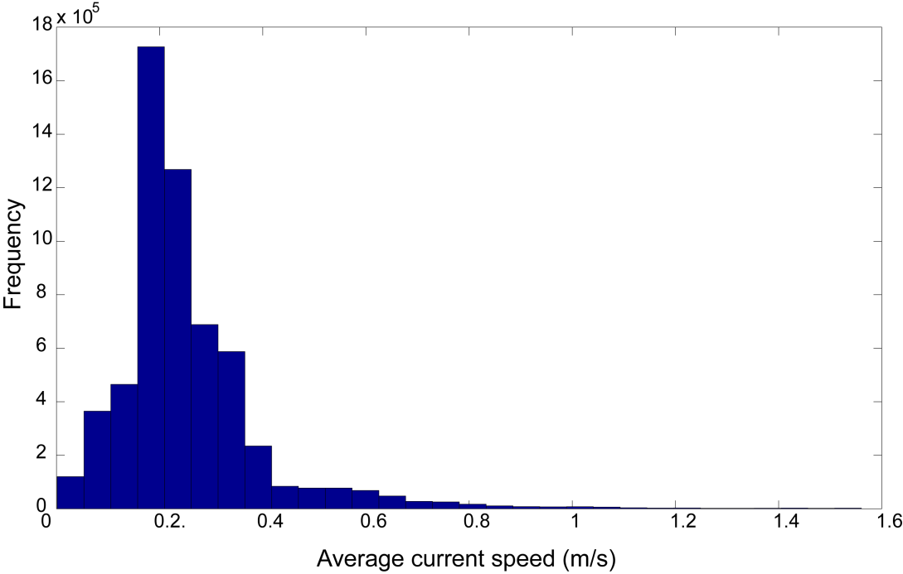
Currents
95% quantile: 0.4 m/s

Slide 16
30 samples randomly selected
100 times
Average statistic and standard error
 |  | DHW |  |  |  | MMM
 |  | Refugia |  | Region |  | Refugia |  | Region
Refugia |  | F-value | p | F-value | p | F-value | p | F-value | p
Upwelling | average | 108.46 | 0.00 | 110.55 | 0.00 | 279.66 | 0.00 | 35.95 | 0.00
 | stdev | 23.08 | 0.00 | 12.26 | 0.00 | 37.40 | 0.00 | 6.90 | 0.00
 | Q 0.025 | 68.11 | 0.00 | 92.23 | 0.00 | 218.50 | 0.00 | 21.30 | 0.00
 | Q 0.975 | 159.23 | 0.00 | 135.41 | 0.00 | 374.01 | 0.00 | 48.53 | 0.00
High latitude | average | 1.35 | 0.42 |  |  | 32.72 | 0.00
 | stdev | 1.60 | 0.27 |  |  | 15.76 | 0.00
 | Q 0.025 | 0.01 | 0.02 |  |  | 11.70 | 0.00
 | Q 0.975 | 5.86 | 0.91 |  |  | 73.79 | 0.00
Strong mixing | average | 2.89 | 0.27 | 210.98 | 0.00 | 13.27 | 0.00 | 486.31 | 0.00
 | stdev | 2.73 | 0.29 | 23.36 | 0.00 | 5.61 | 0.01 | 88.24 | 0.00
 | Q 0.025 | 0.00 | 0.00 | 163.87 | 0.00 | 5.23 | 0.00 | 345.78 | 0.00
 | Q 0.975 | 10.14 | 0.95 | 263.88 | 0.00 | 27.38 | 0.02 | 674.56 | 0.00

Slide 17
